Slide 1
COMPLEX DATA STRUCTURE AND ALGORITHM
UNIT 2

Slide 2
Data Structures Overview
Data structures are ways of organizing and storing data in a computer to make it easy to store, find, and change
Types of Data Structures
1. Primitive Data Structures: Basic types built into programming languages.
  Integers: Whole numbers.
  Floats: Decimal numbers.
  Characters: Individual characters.
  Booleans: True or false values.

Slide 3
2. Non-Primitive (Abstract) Data Structures: More complex structures used to store large and interconnected data.
  Arrays: Collections of elements of the same type.
  Lists: Collections that can contain different data types.
  Linked Lists: Nodes containing values and references to the next node.
  Trees: Hierarchical structures made of nodes.
  Graphs: Collections of nodes connected by edges.
  Stacks: Follow the Last In First Out (LIFO) principle.
  Queues: Follow the First In First Out (FIFO) principle.
  Importance of Data Structures
Facilitate efficient data storage and operations, especially with large datasets
Provide conceptual and practical frameworks for organizing data

Slide 4
Common Operations on Data Structures
Traversing: Accessing each record.
Accessing: Retrieving an element at a specific index.
Searching: Finding an element within a structure.
Insertion: Adding a new element.
Deletion: Removing an element.
Updating: Modifying existing elements.
Sorting: Rearranging elements in order.
Merging: Combining multiple structures.
Splitting: Dividing a structure into smaller parts.

Slide 5
1. Arrays
Arrays: Collections of similar data types stored in consecutive memory locations, accessed by indices.
Arrays are always stored in consecutive (specific) memory location
Example: int a[10]={1,2,3,4,5,6,7,8,9,10};
a[0]=1;
a[1]=2;
a[2]=3;
a[3]=4;
a[4]=5;
a[5]=6;
a[6]=7;
a[7]=8;
a[8]=9;
a[9]=10;

Slide 6
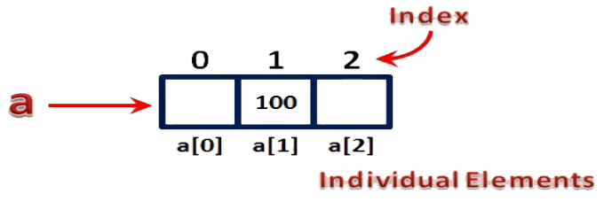
Types of array
a) One-dimensional arrays: is a list of items. It is a linear data structure that stores a collection of elements of the same type in a single list, where each element can be accessed using a unique index starting from 0.
Example:
a[3] means the array named "a" has 3 elements.
You can access the elements using their positions:
a[0], a[1], and a[2].
Notice: The counting starts at 0.

Slide 7
b) Multi-dimensional arrays: are data structures that store data in more than one direction or dimension.
Example:
Two dimensional array ex: a[2][7] as Integer
Three dimensional array ex: a[3][2][5]as Integer
Two dimensional array
It is a list of items arranged in rows and columns, like a table or a matrix.
It has a fixed number of items of the same type.
Each spot where a row and a column meet is called a cell.
Rows and columns are numbered starting from 0

Slide 8
Example:
The array a[3][4] has 3 rows and 4 columns. In a matrix, it looks like this:
a[0][0] a[0][1] a[0][2] a[0][3]
a[1][0] a[1][1] a[1][2] a[1][3]
a[2][0] a[2][1] a[2][2] a[2][3]
Two dimensional array declaration
a two-dimensional array can be declared using the following syntax:
SET Array_name=Array [row size][column size] of Data type
Example:
SET a=Array [2][7] of Integer
SET b=Array [4][3] of Integer
Column 0
Column 1
Column 2
Column 3
Row 0
Row 1
Row 2

Slide 9
Two dimensional array initialization
When you create a two-dimensional array, you need to give values to its elements. This process is called initialization.
Syntax: data_type array_name[rows][columns] =
{ {value1, value2, value3, ...}, // Initializers for row 0
{value1, value2, value3, ...}, // Initializers for row 1
{value1, value2, value3, ...} // Initializers for row 2 // Add more rows as needed
};
Example:
For an integer array with 3 rows and 4 columns i.e A[3][4]:
int A[3][4] = { {1, 2, 3, 4}, {5, 6, 7, 8}, {9, 10, 11, 12} };
BEGIN
SET marks=Array[3] [4] of Integer
Marks [0][0]=18
marks[0][1]=16
Marks [0][2]=14
marks[0][3]=19
Marks [1][0]=10
marks[1][1]=20
Marks [1][2]=12
marks[1][3]=15
Marks [2][0]=15
marks[2][1]=17
Marks [2][2]=18
marks[2][3]=16
END

Slide 10
Accessing two dimensional array elements
1. Reading (storing) two dimensional array elements
To read (store) values in a two-dimensional array, you can get the values from input devices or files. You typically use a function like READ to do this.
FOR i=initial value TO upperlimit DO
FOR j=initial value TO upperlimit DO
READ array name[i][j]
i=i+1
j=j+1
END FOR
END FOR

Slide 11
Example:
BEGIN
SET marks=Array [3] [8] of Integer
Use variable i as integer
Use variable j as integer
FOR i=0 TO 2 DO
FOR j=0 TO 7 DO
READ marks[i] [j]
i=i+1
j=j+1
END FOR
END FOR
END

Slide 12
Writing (displaying) two-dimensional array elements
To display elements of a two-dimensional array, use WRITE array_name[i][j], where i is the row index and j is the column index.
For example:
To display the element at row 1 and column 2, use: WRITE a[1][2]
Example:
BEGIN
SET a=Array[3][8] of integer
Use variable i as integer
Use variable j as integer
WRITE “stored two-dimensional array elements are:”
FOR i=0 to 2 DO
FOR j=0 to 7 DO
WRITE a[i][j]
i=i+1
j= j+1
END FOR
END FOR
END

Slide 13
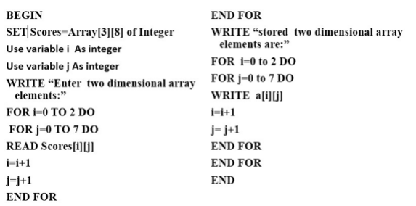
Reading and printing values in arrays

Slide 14
Abstract Data Types
It is a type of data stored and operations supported without specifying implementation details.
Important for handling large amounts of information efficiently.
Notice: Abstract data types perform operations on data structures, including:
Searching: Locating a record with a specific key or finding records that meet certain conditions.
Sorting: Organizing records in a logical order.
1.Lists: The Collections of elements linked together to allow a flexible data management.
2. Linked Lists: It is a dynamic structure with nodes containing data and a reference to the next node, allowing flexible memory usage

Slide 15


To arrange the name of students according to the first letter of their names, we use array or linked list.
Array
Linked list
Types of linked list
Single linked list: is a type of liked list where a list is made up of nodes that contains data part and link part. (each node points to the next node)
This part contains actual data
This part contains the address of the next node

Slide 16
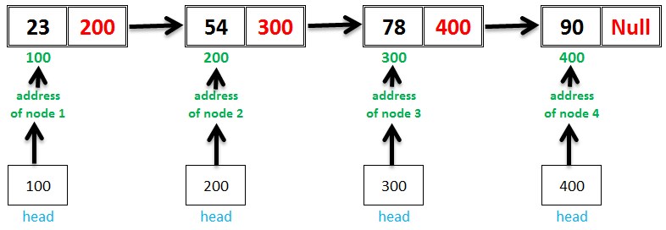
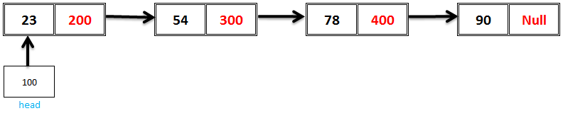
How to represent a single linked list
Suppose we want to store a list of numbers: 23,54,78,90

Slide 17
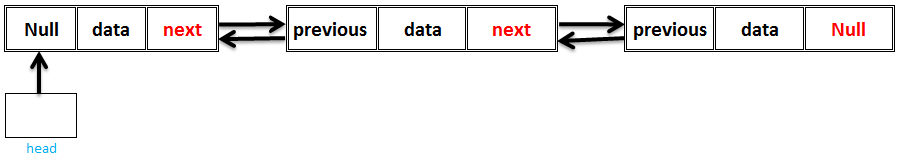
How to access the first node of the linked list
In order to access the first node, we need a pointer (head)
2. Doubly linked list
A doubly linked list is different from a single linked list in a way that each node has an extra pointer that points to the previous node, together with the next pointer and data similar to single linked list.
(each node points to both previous and next node)

Slide 18
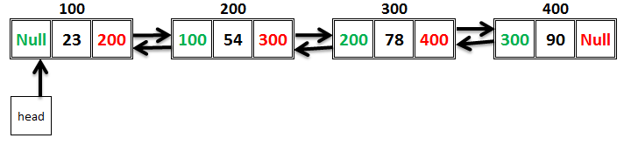

Example: Suppose we want to store a list of numbers: 23,54,78,90 by using doubly linked list.
This means that a doubly linked list has 3 main parts as shown below:
This part points to the previous node or stores the address of the previous node
This part contains actual data (the value of that node)
This part points to the next node or stores the address of the next node

Slide 19
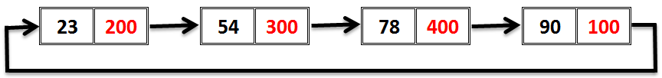
In few words, double linked list is a sequence of elements in which every element has link to its previous and next element in the sequence.
3. Circular linked list
This is a type of linked list where every node points to its next node but the last node points to the first node in the list.
Example: Suppose we want to store a list of numbers: 23,54,78,90 by using circular linked list.

Slide 20

Queue
Queue is a linear list in which data can only be inserted at one end called REAR and deleted from the other end called FRONT. It uses First In First Out (FIFO) principle.
Types of queue
Linear queue
Circular queue
REAR
FRONT

Slide 21

Linear queue
This is a type of queue in which the operations are performed based on the FIFO principle.
b) Circular queue
This is a type of queue in which operations are performed based n FIFO principle and the last position is connected back to the first position to make a circle.
FRONT
REAR

Slide 22
Queue operations
Enqueue: this queue operation inserts an item at the rear of the queue
Dequeue: this queue operation deletes an item at the front of the queue
Display: this queue operation shows elements in array
Stack
A stack is a restricted linear list in which all additions and deletions are made at one end called top, basing on the Last In First Out (LIFO) or First In Last Out (FILO) principle.

Slide 23
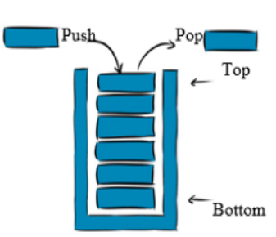
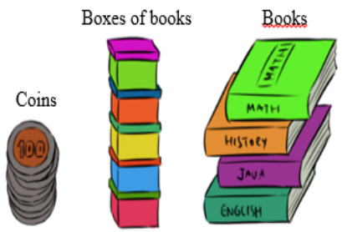
Example: stack of coins, stack of plates, stack of books
How stack operates

Slide 24
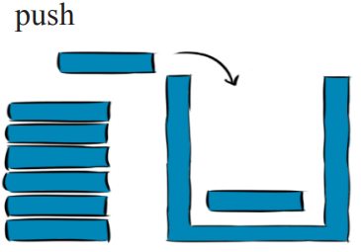
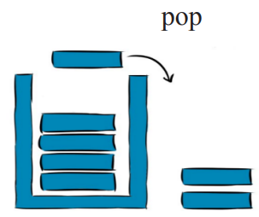
X-tics of stack
It uses LIFO principle
List of the same kind elements
Deletion and addition of elements occurs at the top of the stack.
Operations performed on the stack
Push: adds an element to the stack
Pop: removes an element from the stack
Peek: displays at the top element of the stack
Stack exceptions (errors)
Stack overflow: this error occurs once you try to add an element to an already full stack or queue.
Stack underflow: this error occurs once you try to remove an element from an empty stack or queue.
Notice: Both stack and queue data structure can be implemented using array to organize a limited number of elements or linked list to organize an unlimited number of elements.

Slide 25
Tree
A tree data structure is a collection of nodes organized in hierarchical structure.
In a tree data structure, if we have N number of nodes then we can have a maximum of N-1 number of links
Example:
This tree has 11 nodes and 10 links
N nodes= N-1 links
Every individual element is a node
A
B
C
D
E
F
G
H
I
J
K

Slide 26
Tree terminologies
Root: every tree must have root node (the first node in the tree)
Edge (link): a connecting link between any two nodes
Parent: it is a node which has a branch from it to any other node. (a predecessor of any node)
Child: it is a descendant of any node. All nodes are children except the root node.
A
B
C
D
E
F
G
H
I
J
K
A is root node
A is a parent of B and C. B and C are children of A
B is a parent of D,E and F. D,E and F are children of B
C is a parent of G and H. G and H are children of C
E is parent of I and J. I and J are children of E

Slide 27
e) Siblings: nodes which belong to the same parent node
f) Leaf: it is a node which doesn’t have a child. It is called terminal or external node
g) Internal node: it is a node which has at least a child node
A
B
C
D
E
F
G
H
I
J
K
B and C are siblings
D,E and F are siblings
G and H are siblings
I and J are siblings
D , F, H, I, J and K are leaf nodes
A, B, C, E, G are internal nodes

Slide 28
h) Degree: a degree of a node is the total number of children of that node
Notice: the degree of a tree is the highest degree of a node among all nodes in that tree.
A
B
C
D
E
F
G
H
I
J
K
Degree of A is 2
Degree of B is 3
Degree of C is 2
Degree of E is 2
Degree of G is 1
Degree of K is 0
Hence, degree of the tree is 3

Slide 29
i) Level: a root node is said to be at the level 0 and its children are to be at level 1 and so on.
Level 0
A
Level 1
B
C
Level 2
D
E
F
G
H
Level 3
I
J
K

Slide 30
j) Height: height of a node is the total number of links (edges) from leaf to that node in the longest path.
Notice: the height of the tree is the height of the root node
D, F, H, I, J and K have height of 0
E and G have height of 1
B and C have height of 2
A has height of 3
A
3
3
B
C
1
1
2
2
1
D
E
F
G
H
1
1
1
I
J
K

Slide 31
k) Depth: depth of the node is the total number of edges (links) from root node to that node.
Notice: The depth of the tree is the total number of edges from root node to leaf node in the longest path.
B and C have depth of 1
D, E, F, G and H have depth of 2
I, J and K have depth of 3
A
1
1
B
C
2
2
2
2
2
D
E
F
G
H
3
3
3
I
J
K

Slide 32
l) Path: path is the sequence of nodes and edges from one node to another.
The length of the path is the total number of nodes in that path.
Our tree has paths:
A-B-D
A-B-E-I
A-B-E-J
A-B-F
A-C-G-K
A-C-H
A
B
C
D
E
F
G
H
I
J
K

Slide 33
m) Sub tree: each child node forms a node from a sub tree recursively.
Every child will form a sub tree on its parent node.
A
B
C
Sub tree
Sub tree
D
F
H
G
E
Sub tree
Sub tree
K
I
J

Slide 34

Binary tree representation
A binary tree data structure is represented using two methods:
Linked list of binary tree representation
Array representation
Linked list of binary tree representation
In this representation, each node of the binary tree is represented as node in the linked list where linked node has three fields:
Left[k] stores the address of left child of the node
Info[k] stores the data of the node
Right[k] stores the address of the right child node
Representation of a node

Slide 35
EXAMPLE: Consider the following binary tree:
Node 1: Left child= 2
Data(info)= 1
Right child= 3
Node 2: Left child= 4
Data(info)= 2
Right child= 5
Node 3: Left child= Null
Data(info)= 3
Right child= Null
Node 4: Left child= Null
Data(info)= 4
Right child= Null
Node 5: Left child= Null
Data(info)= 5
Right child= Null
1
2
3
4
5

Slide 36
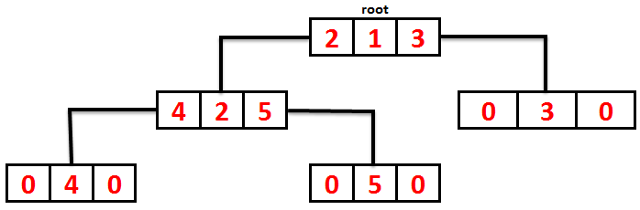
Or
b) Array representation of binary tree
This is a representation where values of the binary tree are stored in an array and the indices of array correspond to the position of the nodes in the binary tree.
Here:
The root N of T is stored in TREE [1]
If node occupies TREE [k], then its Left child is stored in TREE [2k] and its Right child is stored in TREE [2k+1]

Slide 37

Example:
The sequential representation is:
A
B
C
D
E
F
H

Slide 38
Binary tree traversal
A
Traversal is the process of displaying or visiting all nodes of a tree.
Because all nodes are connected via links (edges), we always start from the root node.
a) In-order traversal (left-root-right)
Here, left sub tree is visited first, then the root and later, the right sub tree.
Algorithm: Until all nodes are traversed:
Step 1: recursively, traverse left sub tree
Step 2: Visit root node
Step 3: recursively, traverse right sub tree
4
B
C
6
2
D
E
F
G
1
3
5
7
Left Sub tree
Right Sub tree
D-B-E-A-F-C-G

Slide 39
b) pre-order traversal (root-left-right)
Here, the root node is visited first, then the left sub tree and finally, the right sub tree.
Algorithm:
Step 1: Visit root node
Step 2: recursively, traverse left sub tree
Step 3: recursively, traverse right sub tree
A
1
B
C
5
2
D
E
F
G
3
4
6
7
Left Sub tree
Right Sub tree
A-B-D-E-C-F-G

Slide 40
c) Post-order traversal (left-right-root)
Here, the root node is visited last i.e we first traverse left sub tree, then right sub tree and finally the root node
Algorithm:
Step 1: recursively, traverse left sub tree
Step 2: recursively, traverse right sub tree
Step 3: Visit root node
A
7
B
C
6
3
D
E
F
G
1
2
4
5
Left Sub tree
Right Sub tree
D-E-B-F-G-C-A
A node’s left child must have less than its parent value and the node’s right child must have a value greater than its parent value
27
14
35
10
19
31
42
Left sub tree (keys)<=Node(key)<=Right sub tree(keys)

Slide 41
Basic operations on binary tree
Search: searches an element in a tree
Insert: inserts an element in a tree
Pre-order traversal: traverses a tree in pre-order manner
In-order traversal: traverses a tree in in-order manner
Post-order traversal: traverses a tree in a post-order manner.

Slide 42
Searching and sorting using complex data structure
searching: is a process of finding the location of a given element in a set of elements.
Linear search: this method traverses a list sequentially to locate the search key.
Binary search: this method works on a sorted lists by progressively making better guesses to find location of a search key.
Linear search algorithm
Linear search or sequential search is a simple method used for searching an array for a particular element.
“a” is an array of the size “n”
“n” is the size of the array “a”
“Item” is the element to find in the array “a”
“Loc” is the index of the element in the array “a”

Slide 43
Algorithm
Bigin
For i=0 to (n-1) by 1 do
If(a[i]=item) then
Set Loc=I
Print loc exit
End if
Set loc+1
End for
end

Slide 44
Linear search algorithm is a simple algorithm that sequentially checks each element in a list until it finds the target value.
Start at the beginning of the list
Compare each element in the list with the target value
If a match is found, returns the index of the element
If the end of the list is reached without finding a match, return a “not found” indicator.
Example: let’s say that a list of numbers: [5,2,8,10,3,6]. We want to find the index of the number 10 using a linear search.
Solution:
Start at the first element 5 and compare it with 10, not a match
Move to the next element 2 and compare it with 10, not a match
Move to the next element 8 and compare it with 10, not a match
Move to the next element 10 and compare it with 10, a match found, Return the index of 10 which is 3

Slide 45
ii) Binary search/dichotomy/bisection method
You search an array by repeatedly dividing the search interval in half.
While dividing, you begin with the interval covering the whole array.
If the value of the search key is less than the item in the middle of interval, narrow the interval to the lower half. Otherwise, narrow it to the upper half.
Repeatedly check until your value is found or the interval is empty.

Slide 46

Example:
Use binary search to find the location of 9.
Here:
start=0 end=6 for a full array key=9
Mid=(start+end)/2=(0+6)/2=3
Does a[mid]=key ?, a[3]=9
9>a[mid] or 9>a[3] or 9>12
End=mid-1 end=3-1 end=2 start=0
Mid=(0+2)/2=1 mid=1
Does a[mid]=key ?, a[mid]=9 ?, a[1]=9 ? 8 ≠9 and 8<9
then start= mid+1 start=1+1 start=2 end=2
Mid=(2+2)/2=4/2=2
Does a[mid]=key ? a[2]=9 ? 9=9
Hence, 9 is found at index 2 and our search is successful

Slide 47
For not successful search, you conclude that the element is not found once start>end
Algorithm:
Begin
Set start=0
Set end=n-1
Set mid=(start+end)/2
While ((start<=end) and (a[mid]!=item) do
If(item<a[mid]) then
Set end=mid-1
else
Set start=mid+1
End if
Set mid=(start+end)/2
End while
If(start>end) then
Set loc=-1
else
Set loc=mid
End if
end

Slide 48
Sorting using complex data structure
Sorting is the process of arranging elements in some logical order either ascending or descending
Methods of sorting
Bubble sort
Insertion sort
Selection sort

Slide 49
Bubble sort
This is a simple sorting algorithm that works by repeatedly swapping the consecutive elements if they are not in the intended order
Start at the beginning of the list
Compare each pair of consecutive elements
If the elements are not in intended order, swap them
Repeat step 2 and 3 until the end of the list is reached
Repeat the step 1 to 4 until the list is sorted

Slide 50
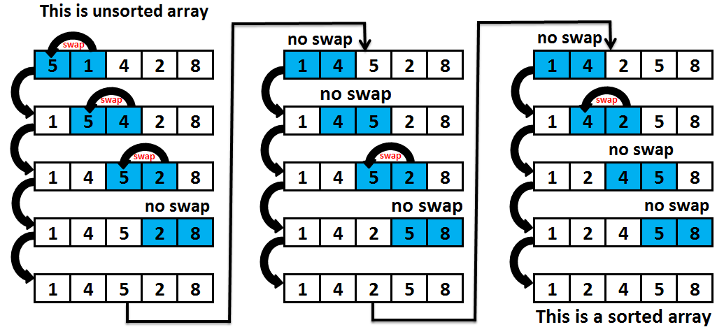
Phase 1
Phase 2
Phase 3

Slide 51
Bubble sort algorithm
Begin
For k=1 to (n-1) by 1 do
For j=0 to (n-k-1) by 1 do
If(a[j]>a[j+1] then
Set temp=a[j]
Set a[j]=a[j+1]
Set a[j]=temp
End if
End for
End for
end

Slide 52
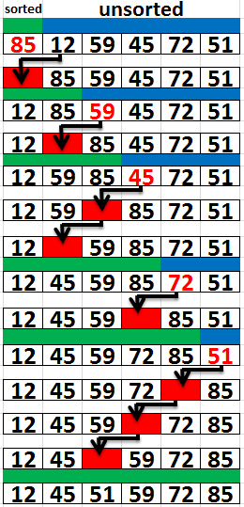
INSERTION SORT
Insertion sort is a simple sorting algorithm that builds the final sorted array (list) one item at a time by comparison.
It is a simple sorting algorithm that virtually splits the given array into sorted and unsorted parts, then the values from the unsorted parts are picked and placed at the correct position in the sorted part.

Slide 53
Insertion sort algorithm
Begin
For i=1 TO n-1
J=i
Do while (j>0) and A(j)<A(j-1)
Temp=A(j)
A(j)=A(j-1)
A(j-1)=Temp
J=j-1
End Do
End for
End

Slide 54
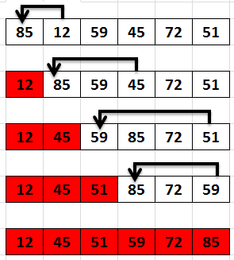
SELECTION SORT
Is a sorting algorithm that works by repeatedly selecting the smallest or largest from the array and replacing it in its correct position
To sort in ascending order;
Find the minimum element in the list
Swap it with the element in the first position

Slide 55
Selection Sort Algorithm
Begin
For I = 0 to N-1 do:
Smallsub = I
For J = I + 1 to N-1 do:
A(J) < A(Smallsub)
Smallsub = J
End-If
End-For
Temp = A(I)
A(I) = A(Smallsub)
A(Smallsub) = Temp
End-For
End

Slide 56
Apply algorithm to solve complex mathematical functions
Understanding Quadratic Equations:
A quadratic equation is in the form ax2+bx+c=0, where x is the unknown and a,b,c are constants. It is a second-degree polynomial.
2. Recursive Functions: A recursive function calls itself during execution, producing results at the end of each cycle. Key examples include:
Summing a List: A function that calculates the sum of numbers in a list.
Factorial Function: Computes n!, the product of all positive integers up to nn (e.g., 4!=24*0!=24).
Fibonacci Series: A sequence where each number is the sum of the two preceding ones (e.g., 0, 1, 1, 2, 3...).

Slide 57
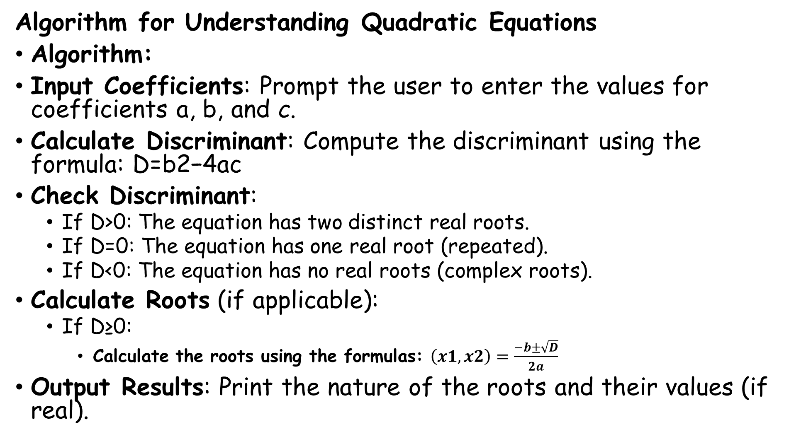

Slide 58
What is a Fibonacci Series?
Fibonacci series is a sequence of numbers where each number is the sum of the two preceding ones.
Example: 0, 1, 1, 2, 3, 5, 8, 13, 21, ...
Generate the first n terms of the Fibonacci series.
Steps:
Start
Initialize variables:
  a = 0, b = 1
Display a and b
Repeat for the remaining terms:
  next = a + b
  Display next
  Update a = b, b = next
Stop
Pseudocode: Fibonacci Series
BEGIN
INPUT n
SET a ← 0
SET b ← 1
PRINT a, b
FOR i ← 2 TO n DO
SET next ← a + b
PRINT next
SET a ← b
SET b ← next
END FOR
END
#include <iostream>
using namespace std;
int main()
{
int n, a = 0, b = 1, next;
cout << "Enter the number of terms: ";
cin >> n;
cout << "Fibonacci Series: " << a << " " << b << " ";
for (int i = 2; i < n; i++)
{
next = a + b;
cout << next << " ";
a = b;
b = next;
}
return 0;
}
Applications:
Sorting and searching algorithms
Stock Trading
3D modeling
Population Growth Modeling
Music
plants, flowers, and fruits.
Architecture and Art

Slide 59
What is a Factorial?
The factorial of a number n (written as n!) is the product of all positive integers from 1 to n.
Example: 5! = 5 × 4 × 3 × 2 × 1 = 120
Algorithm for Factorial
Find the factorial of a given number n.
Steps:
Start
Input n
Initialize fact = 1
Repeat from i = 1 to n:
  fact = fact * i
Display fact
Stop
Pseudocode
BEGIN
INPUT n
SET fact ← 1
FOR i ← 1 TO n DO
fact ← fact * i
END FOR
PRINT "Factorial =", fact
END
#include <iostream>
using namespace std;
int main()
{
int n;
long long fact = 1; // use long long for large results
cout << "Enter a number: ";
cin >> n;
for (int i = 1; i <= n; ++i)
{
fact *= i;
}
cout << "Factorial of " << n << " = " << fact;
return 0;
}

